Slide 1

Topic 1: The Concept of Infection Control
[Date of training]
Notes:
Participants log in and get settled

Slide 2

Agenda:
Project Firstline and the concept of infection control
  Video
  Discussion and reflection
Session feedback form and next steps
Learning Objectives:
Articulate at least one (1) primary goal of infection control
Notes:
Sample Script
“Welcome! Thank you for joining us for this segment of today’s meeting. We’re going to carve out some time during upcoming meetings for some short 10-minute segments on infection control. Over time, we’ll be watching some short videos together and thinking about our day-to-day work. Today’s session will be very general in nature, but in future sessions we’ll get deeper into the details of infection control.”

Slide 3
Why do we do infection control?
Notes:
Sample Script
“Since we only have 10 minutes together, let’s jump right in. I’d like to begin with a question. Why do you personally do infection control? I’d like to play for you a brief video from a CDC doctor who talks about this. As we watch the following video, I invite you to think about this question and post your answers in chat. Infection control is important for so many reasons.”

Slide 4
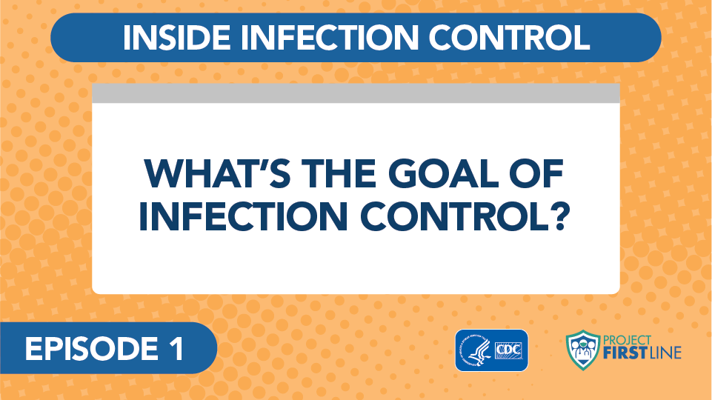
Video: What’s the Goal of Infection Control?
Notes:
Access the video here:
CDC website: https://www.cdc.gov/infectioncontrol/projectfirstline/videos/Ep1-Goal-LowRes-New.mp4
Or
Project Firstline YouTube Playlist:
https://www.youtube.com/watch?v=atLgq4fsVvo

Slide 5
Upcoming Session Topics
Coming up next
Broader Themes and Topics
  The Basic Science of Viruses
  How Respiratory Droplets Spread COVID-19
  How Viruses Spread from Surfaces to People
  How COVID-19 Spreads: A Review
  Infection Control: The Basics
  Source Control
  PPE: Basics
  PPE: Donning and Doffing
  Hand Hygiene
  Crisis Standards of Care
  Triage
  Standard and Transmission-Based Precautions
  Microbiology Basics
  Recognizing Risk
  Environmental Cleaning and Disinfection
Notes:
Sample Script
“I see some great answers to the question in the chat. Infection control is important for all these reasons. We engage in infection control strategies to keep everyone safe and healthy. More key messages from today are listed in your participant booklet.
“Project Firstline aims to explain the “whys” of infection control, to explain the reasons for current guidance, and to give us all a chance to get our own questions answered. So, what questions do you have? This slide shows some of the topics we’ll cover in upcoming sessions. If you have questions about anything related to infection control on the job, please post it in chat. CDC is collecting questions from the frontlines to include in future video episodes and training materials. We want to make sure your voices get heard, and after today’s session I’m going to submit our group’s questions to CDC.”

Slide 6
Key Messages
The goal of everything we do in infection control, for any disease, is to keep people from getting sick.
The goal of Project Firstline is to make sure you have the infection control knowledge that you need and deserve to keep yourself, your patients, your colleagues, and your family safe.
Notes:
Sample Script
“Before we close today, I’d like to point out that you’ve been given a participant booklet with each session’s learning objectives and key messages, as well as some space to write. Please feel free to use this space to reflect further on today’s session. The booklet is for you.”

Slide 7
Resources and Future Training Sessions
Project Firstline on CDC:
https://www.cdc.gov/infectioncontrol/projectfirstline/index.html
Project Firstline on Facebook:
https://www.facebook.com/CDCProjectFirstline/
Twitter:
https://twitter.com/CDC_Firstline
YouTube Playlist:
https://www.youtube.com/playlist?list=PLvrp9iOILTQZQGtDnSDGViKDdRtIc13VX
To sign up for Project Firstline e-mails, click here: https://tools.cdc.gov/campaignproxyservice/subscriptions.aspx?topic_id=USCDC_2104
Notes:
Sample Script
“Next time, we will dig into some basic microbiology, how viruses work, and how COVID-19 makes us sick. In the meantime, you can keep exploring these topics on your own using the resources on this slide. You can also follow us on social media. Finally, I’d like to share a small welcome gift as a thank you for participating today.”
[Digitally distribute “Project Firstline Is for You” poster.]

Slide 8
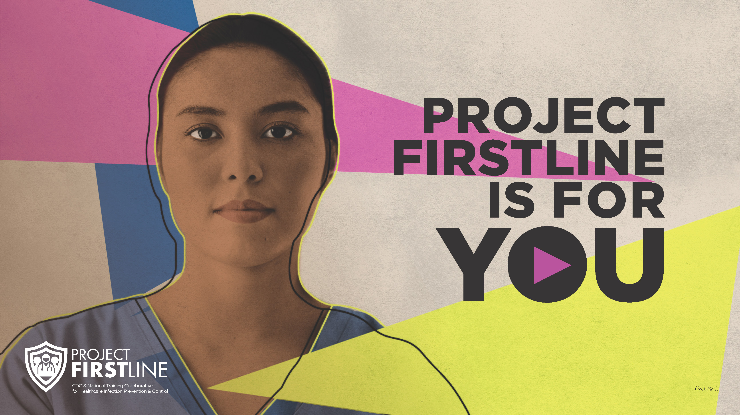
Feedback form
Notes:
[Facilitator should add information about how to access form]
Sample Script
“And finally, please let us know how you enjoyed today’s session by completing the following feedback form. Thanks again for joining us today.”

